Slide 1
Calculus
AI ToolKit
Fall Semester, 2023
Notes:
How can summarize matrices, how matrices can be decomposed.

Slide 2



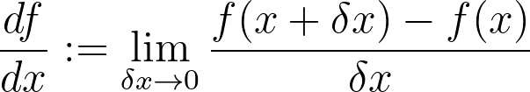
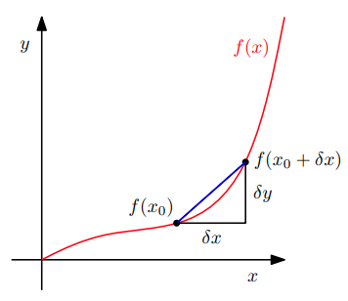
Function and Machine Learning
Goal of machine learning is to approximate the unknown real function with ,
where is a model parameter.
We want to find optimal , which can optimize the objective function.
What kinds of objective function?
⇒
If objective functions are differentiable, can we find optimal easily?

Slide 3
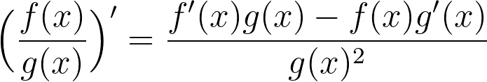
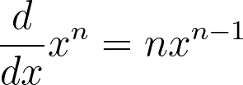
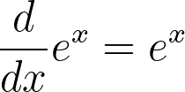
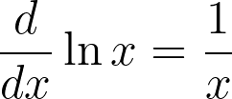
Differentiation Rules
Product rule
⇒
Quotient rule
⇒
Sum rule
⇒
Chain rule
⇒

Slide 4
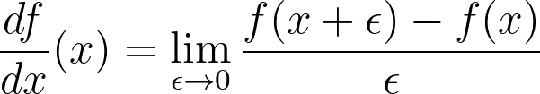
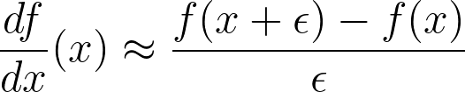
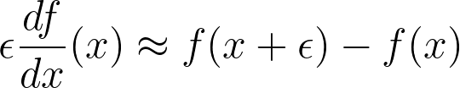
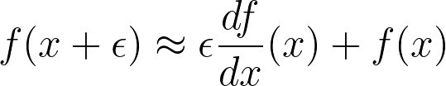
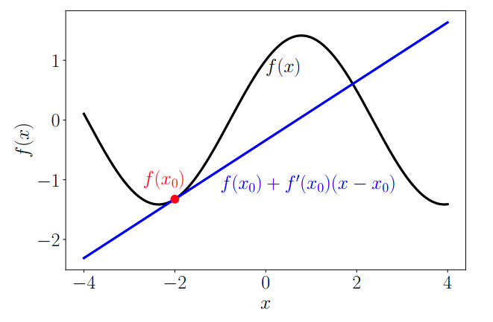
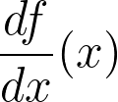

Derivative and Approximation
⇒ ⇒ ⇒
⇒ Approximate the value of by a line which passes with slope of .
⇒ Can we expand this approximation into n-th order polynomial?

Slide 5
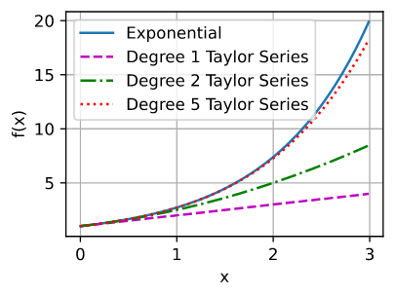


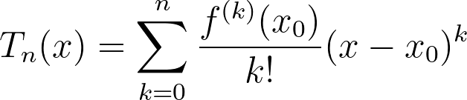


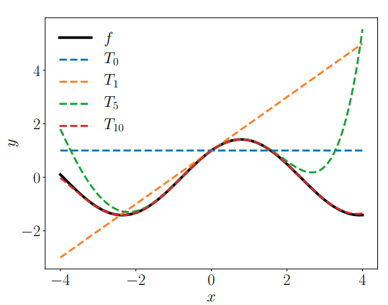
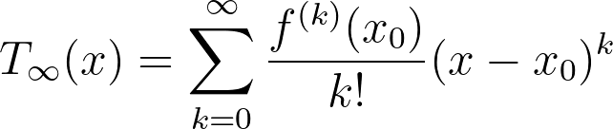
Taylor Series
The Taylor polynomial of degree of at is defined as:
⇒
If the Taylor series of at is defined as:
⇒

Slide 6
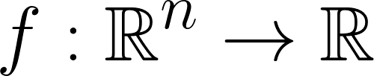
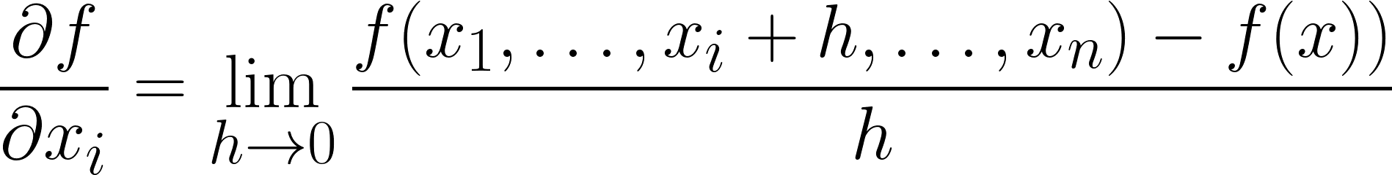
Partial Differentiation and Gradient
For a function , partial derivative is defined as:
⇒
If partial derivatives are collected into the row vector, gradient of a function is obtained.
⇒

Slide 7
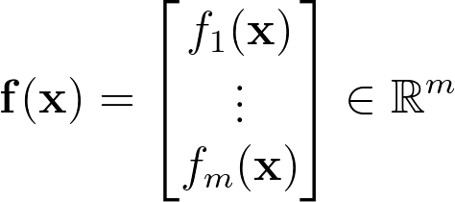


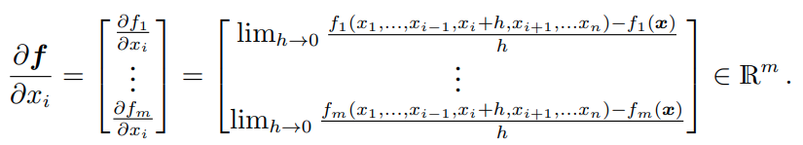
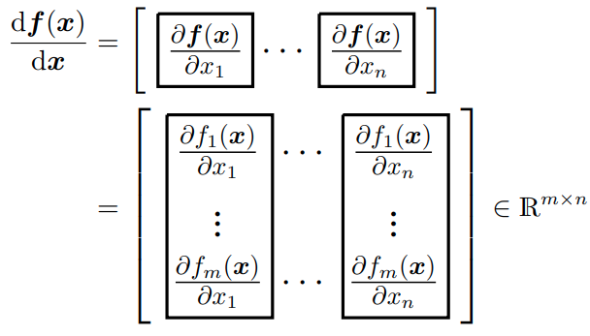
Gradients of Vector-Valued Functions
For , a vector-valued function is .
Its partial derivative is given as a vector,
And its gradient is given as a matrix, by collecting these partial derivatives:

Slide 8
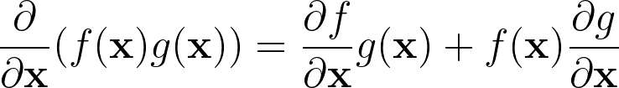
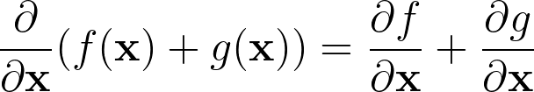
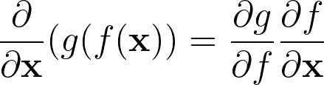



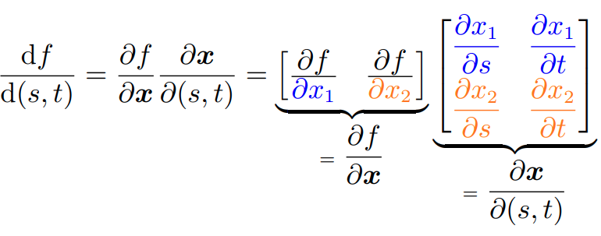
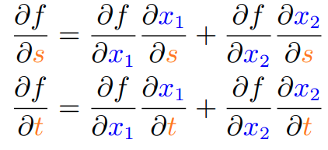
Rules of Partial Differentiation
Product rule, sum rule, chain rule also applies for partial differentiation.
If and & ,
⇒ ⇒
⇒ The chain rule can be written as a matrix multiplication

Slide 9
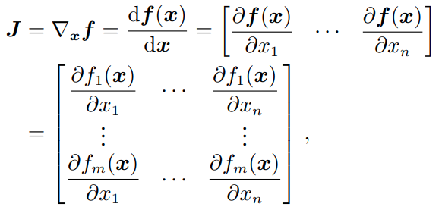
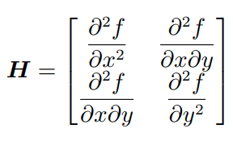

Jacobian and Hessian
Jacobian: the collection of all 1st-order partial derivatives of a function .
⇒is
Hessian: the collection of all second-order partial derivatives
If ,
If , the Hessian is an (m x n x n) tensor.

Slide 10

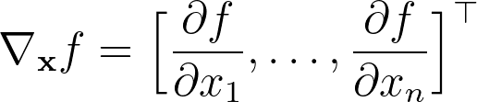



Higher-Dimension Differentiation and Approximation
Recall .
Similarly,
If we repeat this, .
Let and , then .
What happens if we consider as our objective function , and ?
⇒
⇒ Can we relate this with optimization?

Slide 11
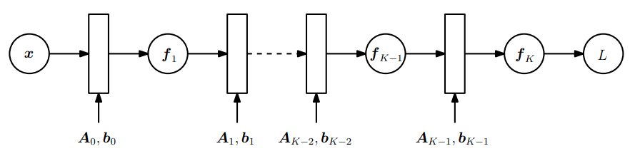



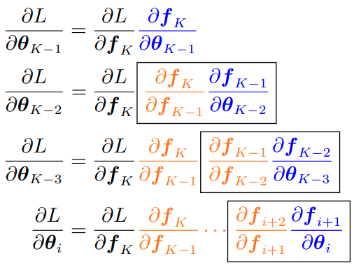
Gradients, Backpropagation, Chain Rule, and Neural Network

Slide 12
Any Questions?

